Slide 1
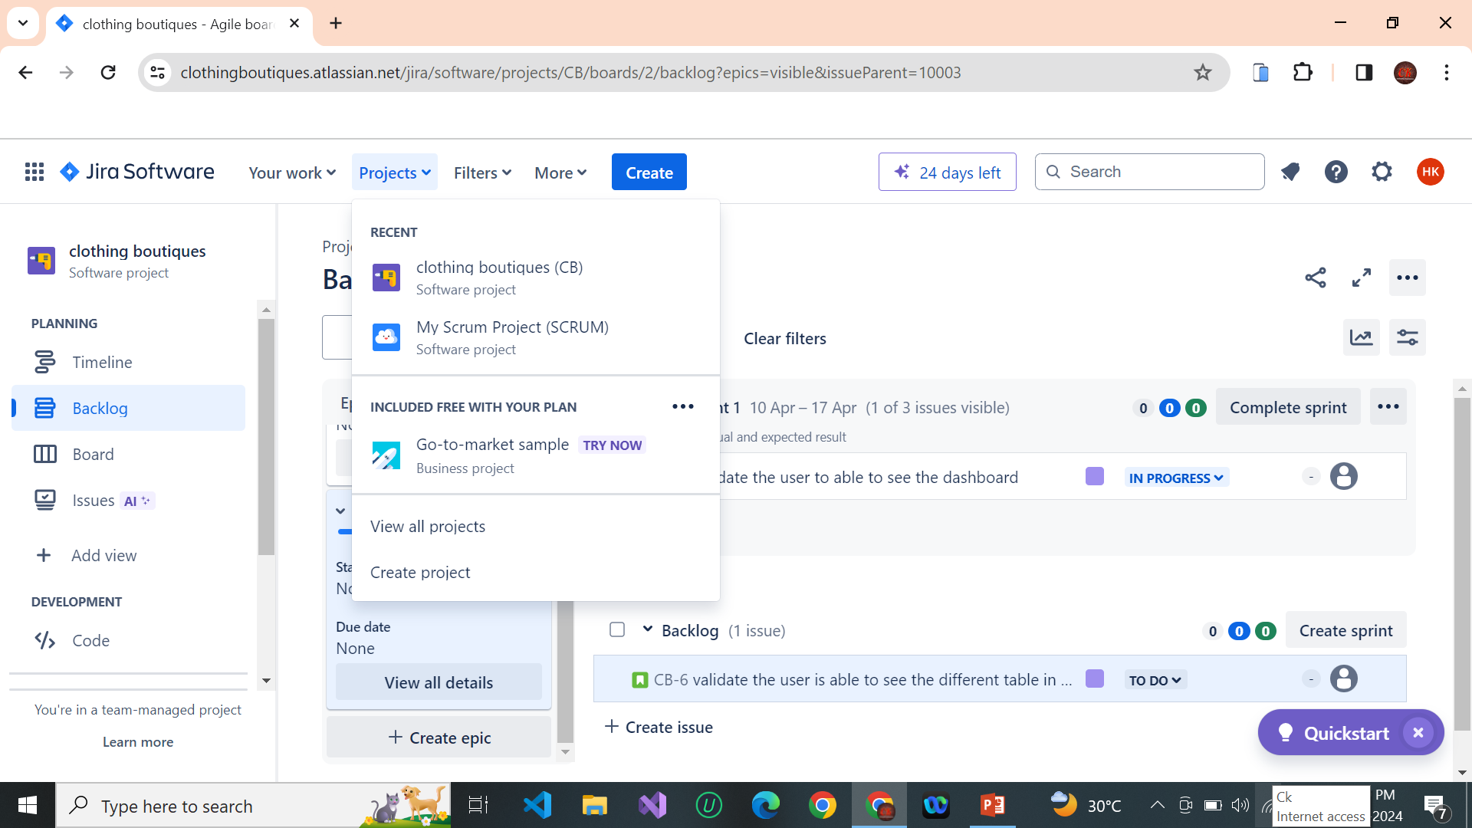
ASSIGNMENT 14
JIRA PROJECT CREATION
STEP 1 : CREATE A NEW PROJECT . CLICK PROJECTS -> CREATE PROJECT

Slide 2
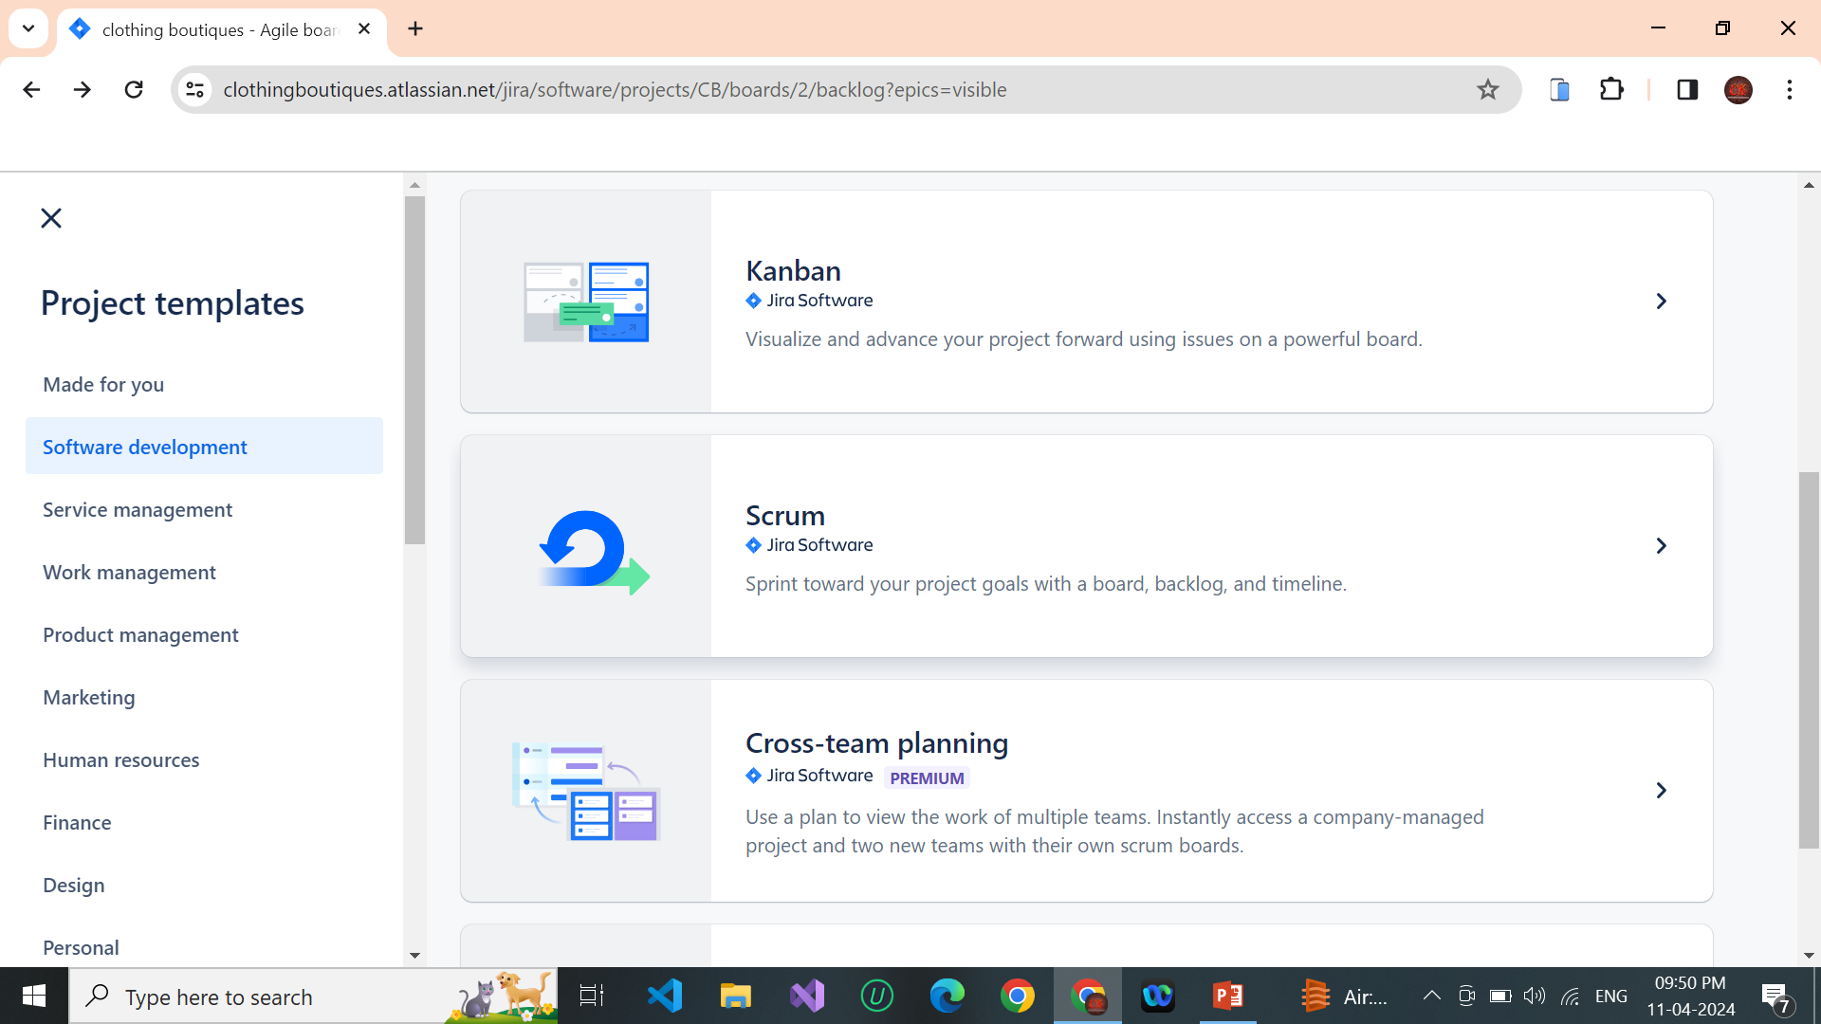
STEP 2: CLICK SOFTWARE DEVELOPMENT -> SCRUM

Slide 3
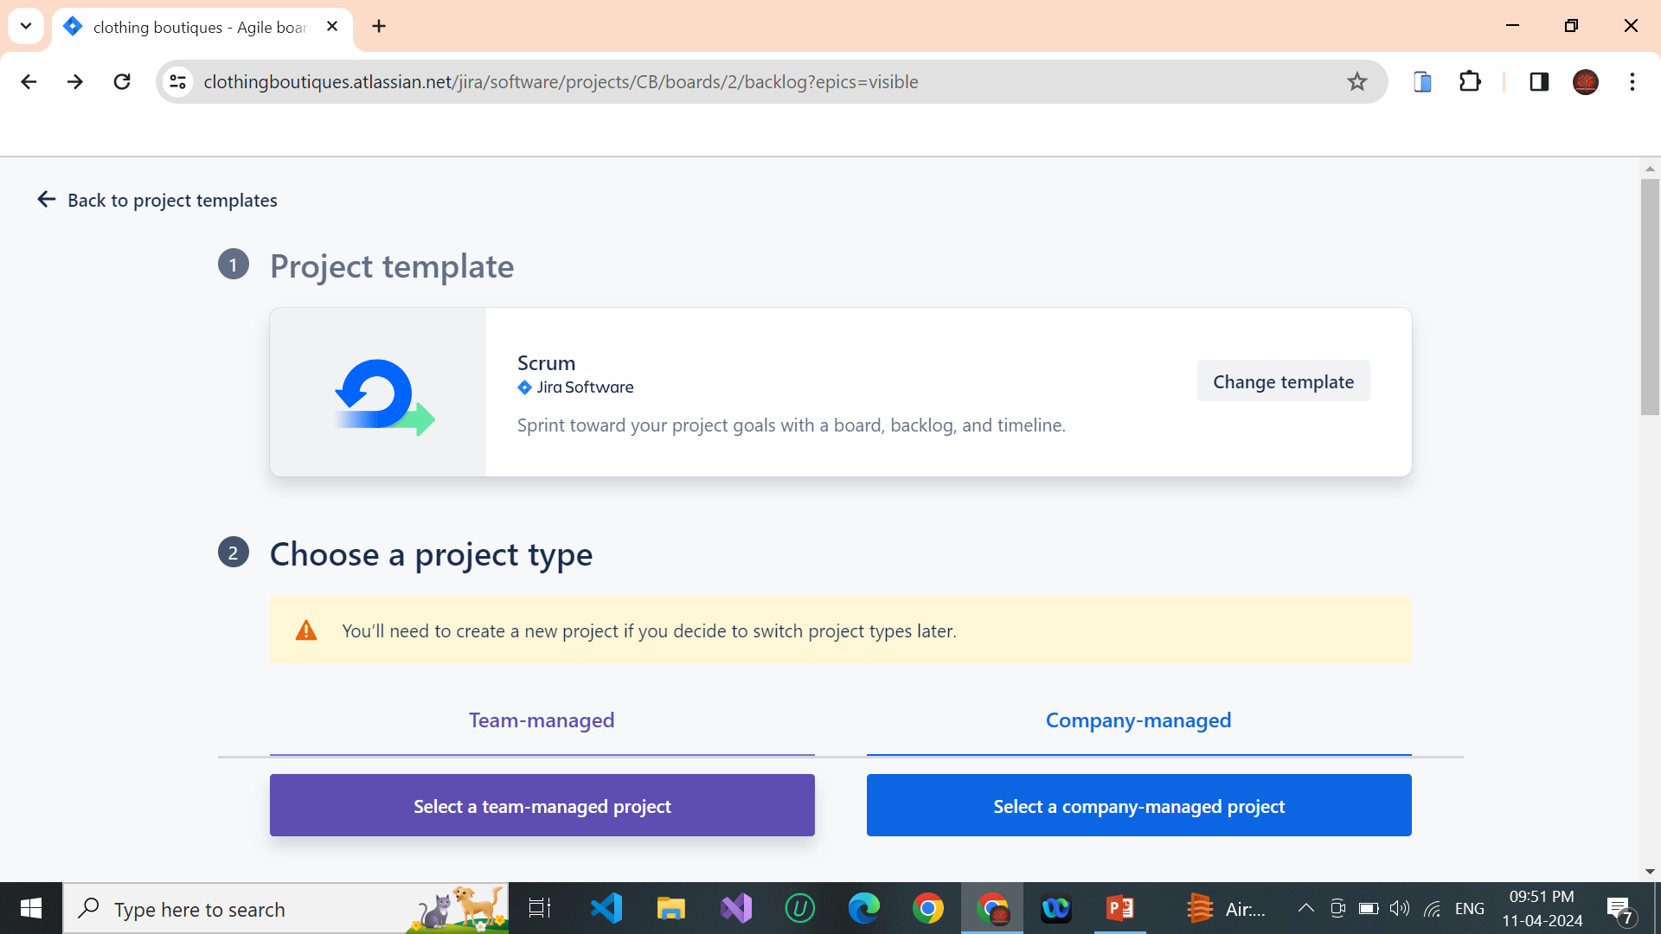
STEP 3 : SELECT A TEAM MANAGED PROJECT

Slide 4
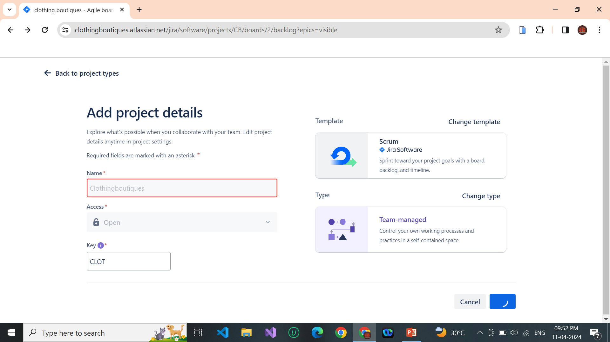
STEP 4 : ADD PROJECT DETAILS ( TYPE OUR OWN PROJECT NAME)

Slide 5
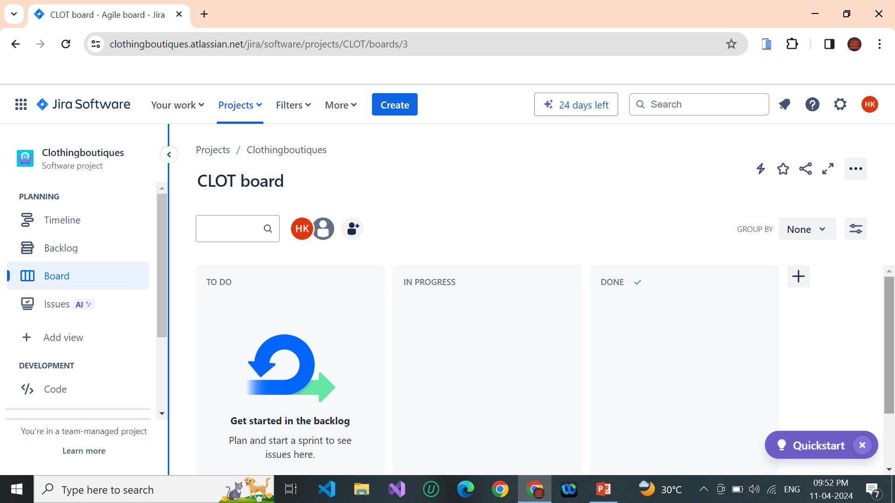
STEP : 5 AFTER CREATE A PROJECT NAME AND GO TO PROJECT DASHBOARD

Slide 6
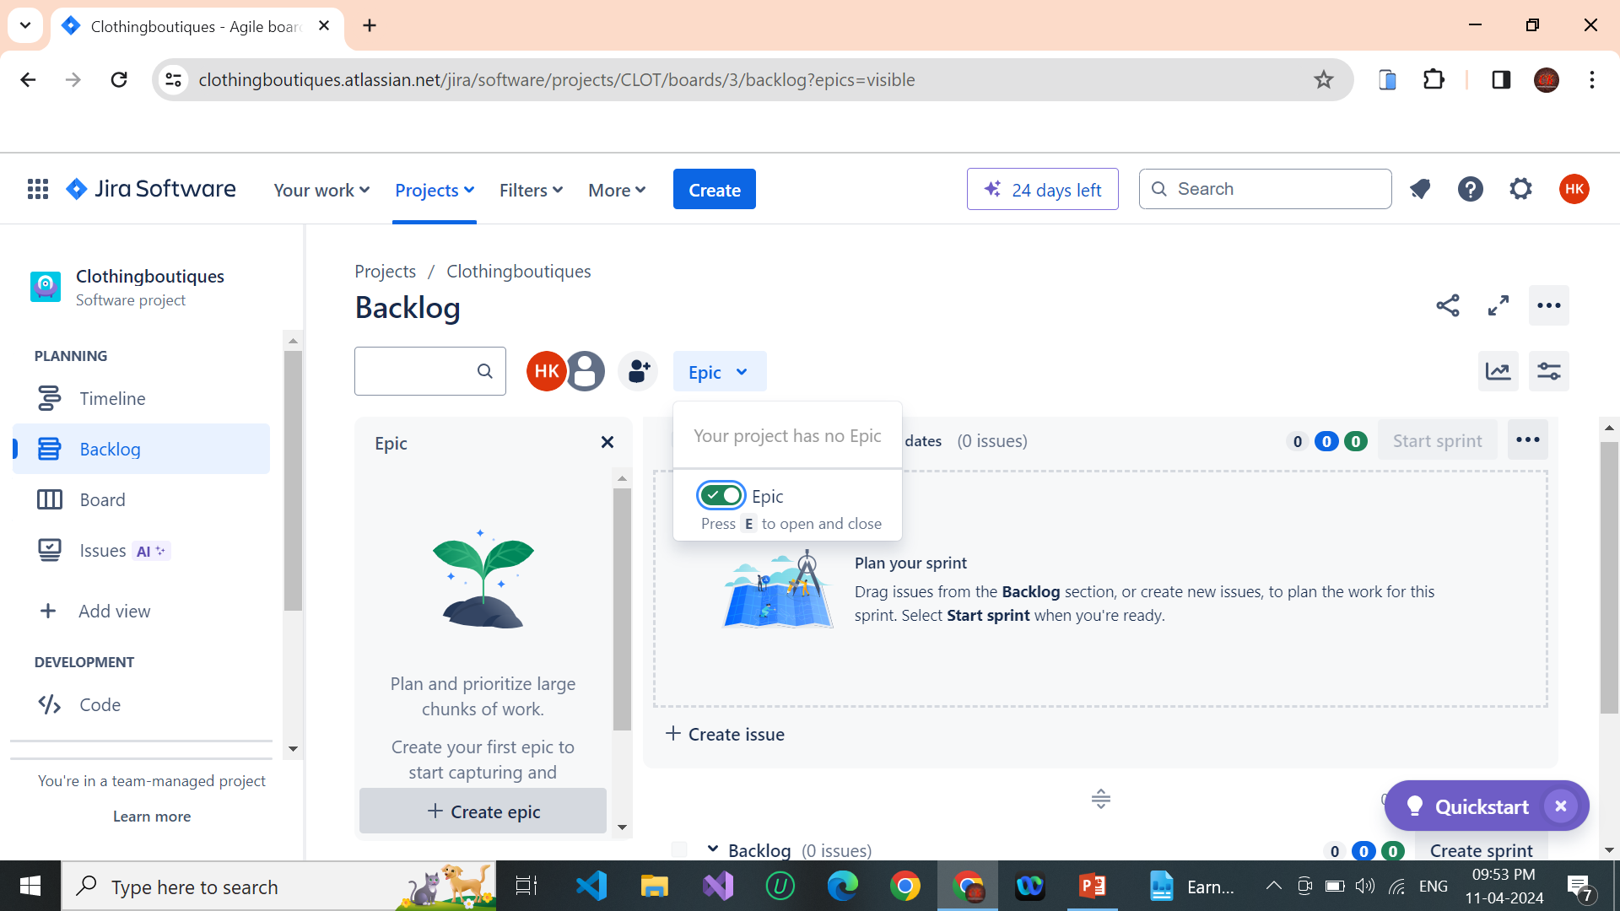
STEP 6 : FIRST WE CLICK THE BACKLOG TO TURN ON EPIC ()CREATE NO.OF . STORY UNDER ONE EPICS

Slide 7
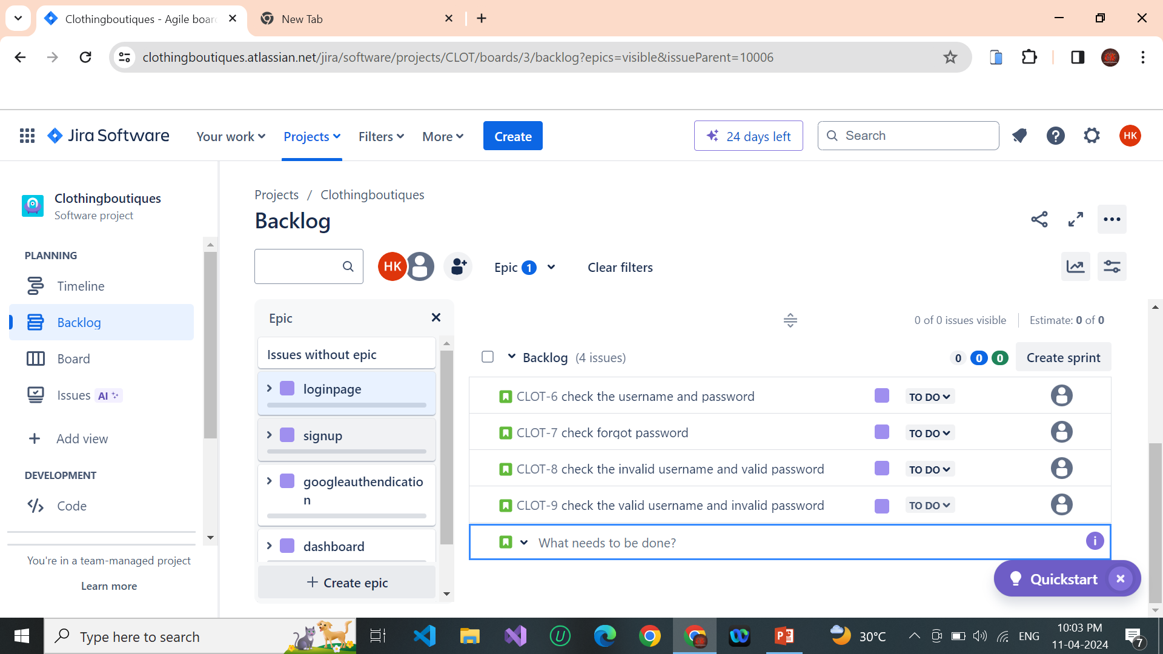
STEP : 7 – CREATE BACKLOG (CREATE ISSUE) AND DRAG INTO SPRINT AREA… AT LAST WE CLICK TO SPRINTSTART

Slide 8
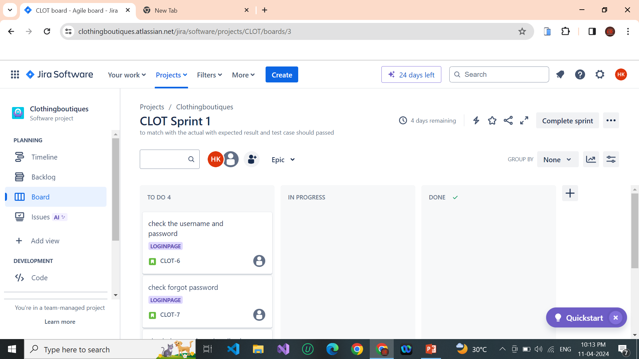
STEP 8: AFTER WE CLICK THE SPRINT BUTTON TO CHECK THE MATCH WITH THE ACTUAL WITH EXPECTED RESULT AND TEST CASE SHOULD PASSWED … DRAGE TO ONE EPIC (IN PROGRESS).

Slide 9
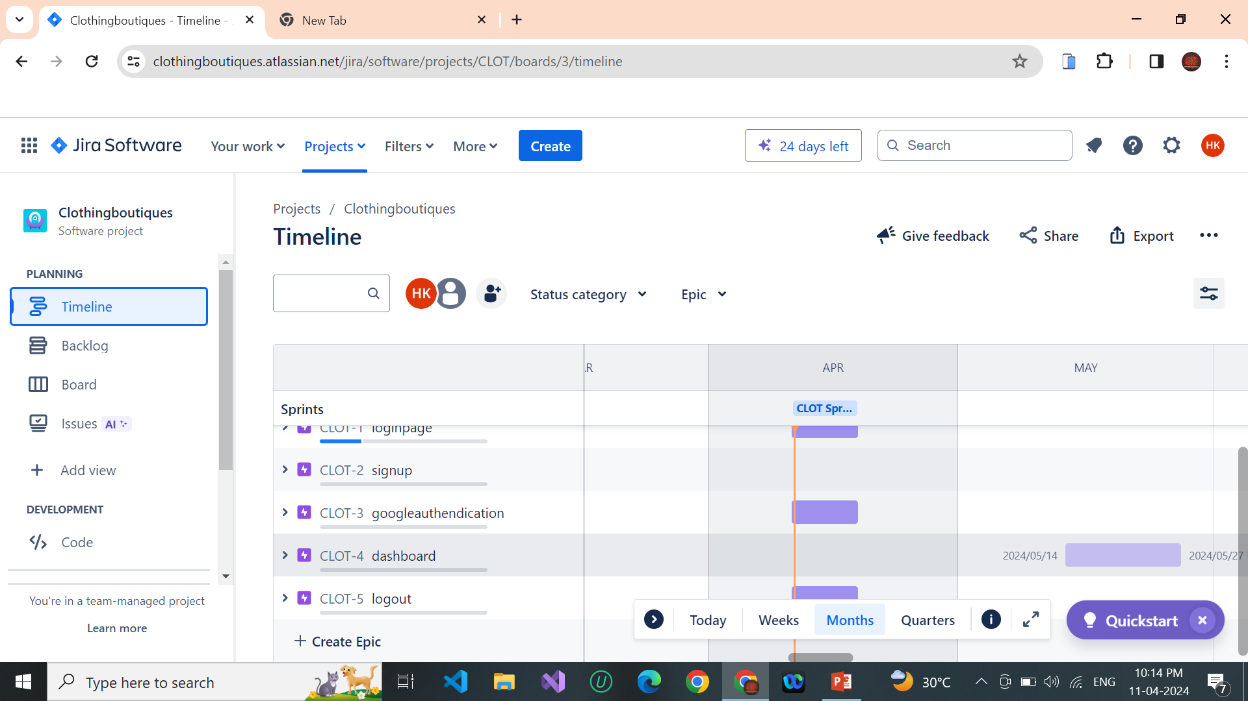
STEP 9: WE CLICK TO CHECK THE TIMELINE ….

Slide 10
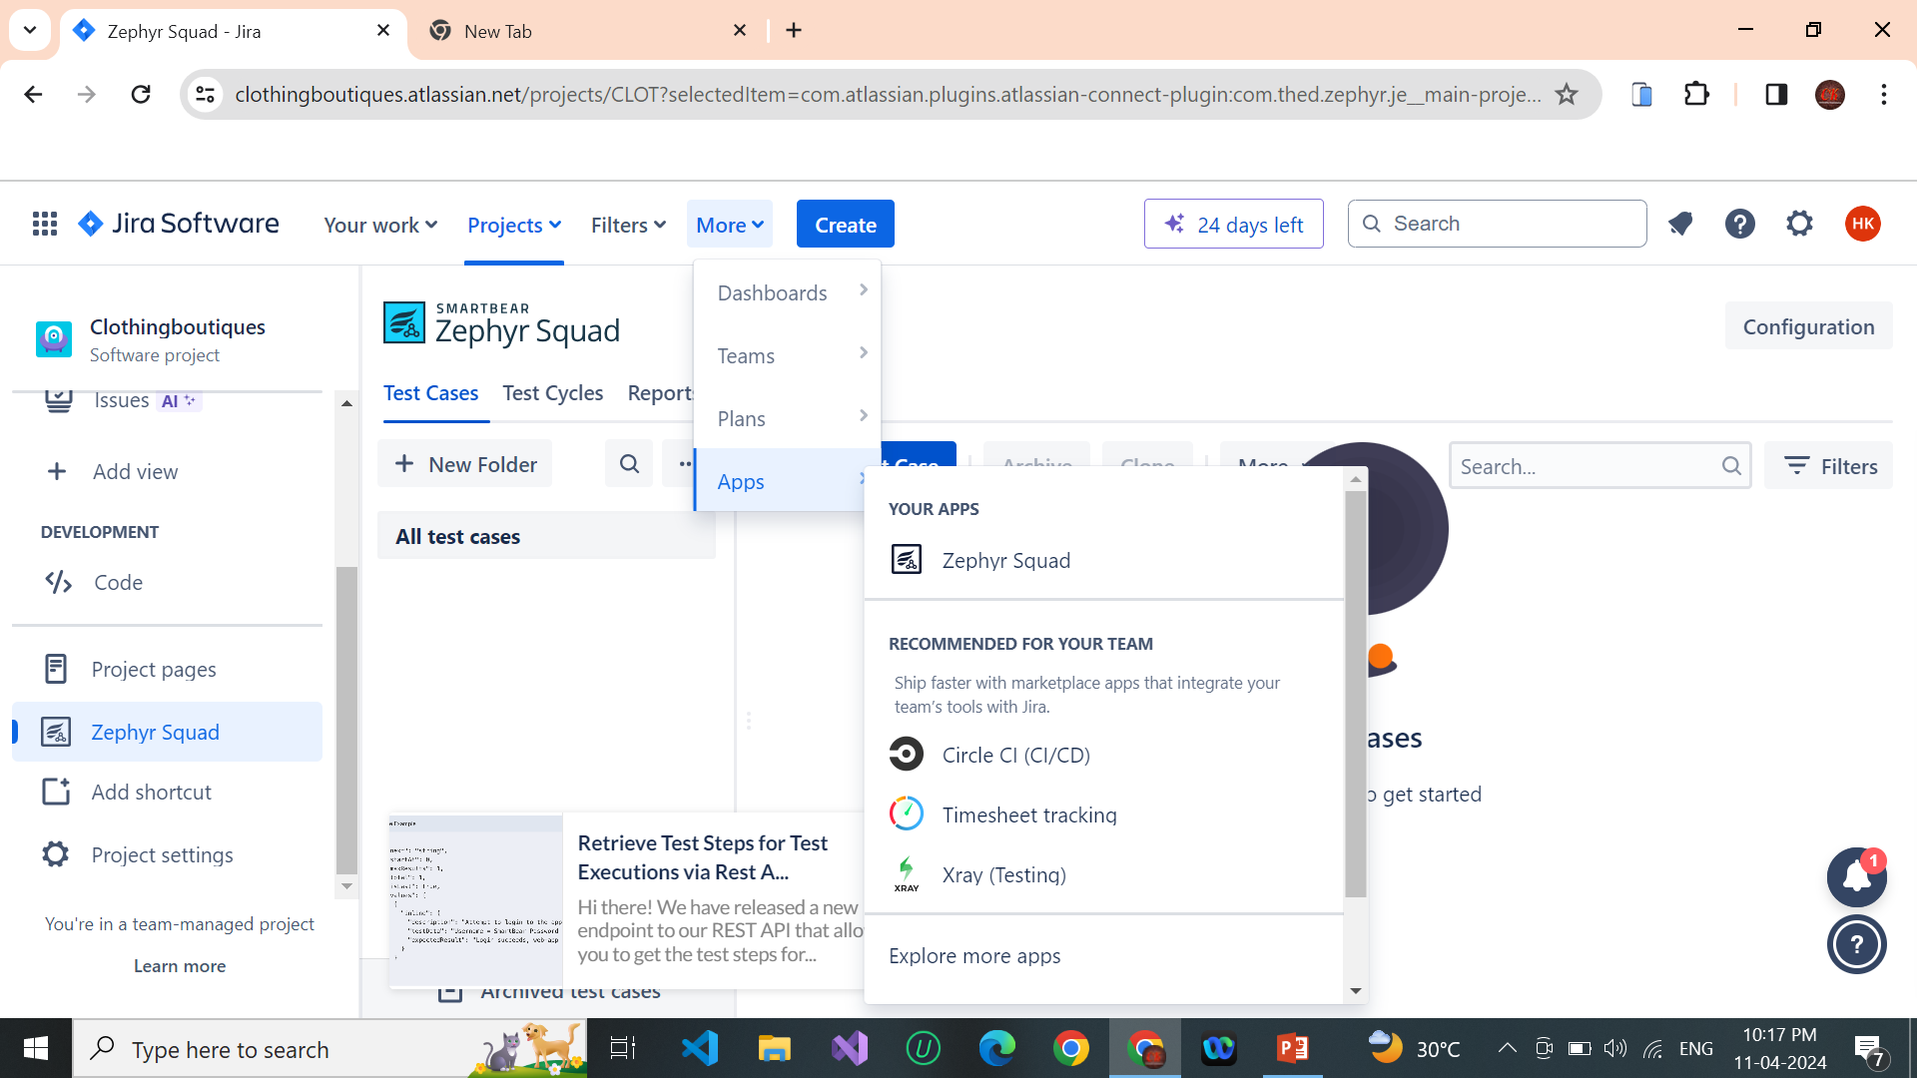
STEP 10 : WE INSTALL THE ZEPHYR SQUARD.. CLICK -> APPS -> INSTALL ZEPHYR SQUARD

Slide 11
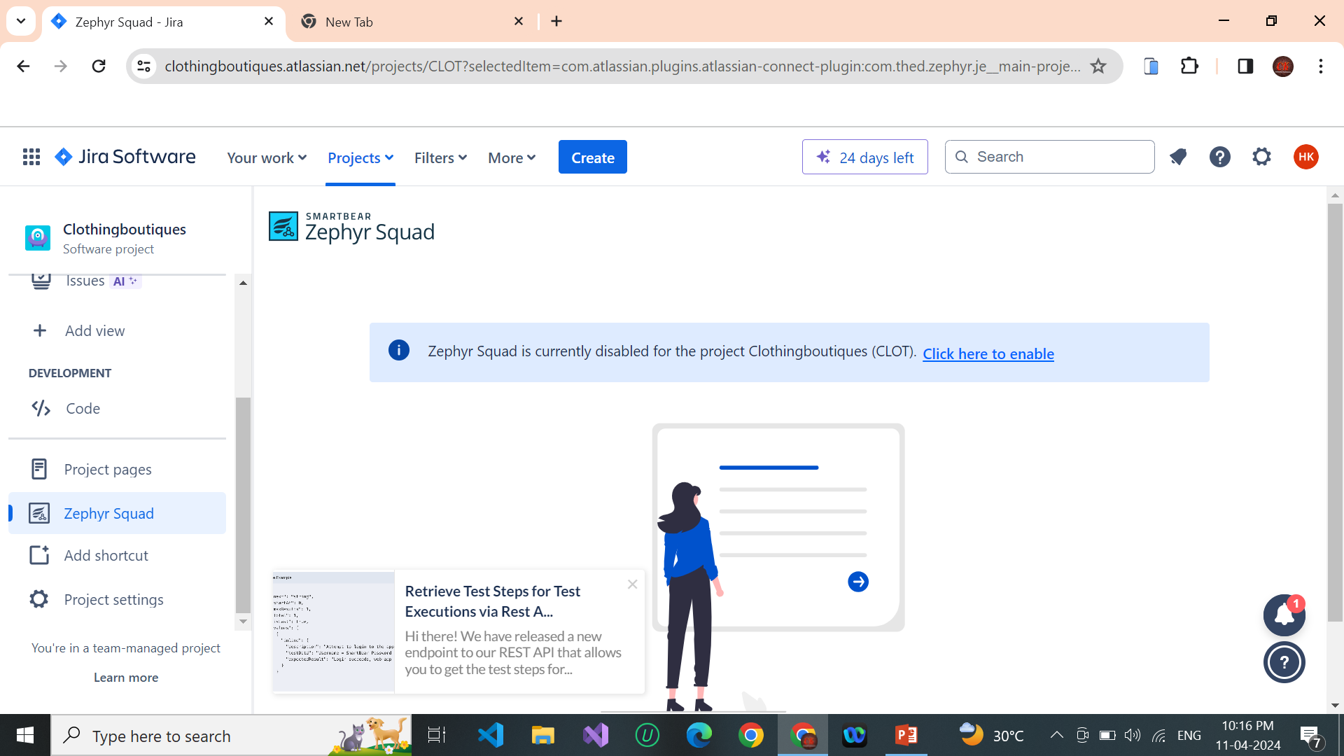
STEP 11 : AFTER WE INTALL THE ZEPHYR SQUARD AND CLICK TO ENABLE…

Slide 12
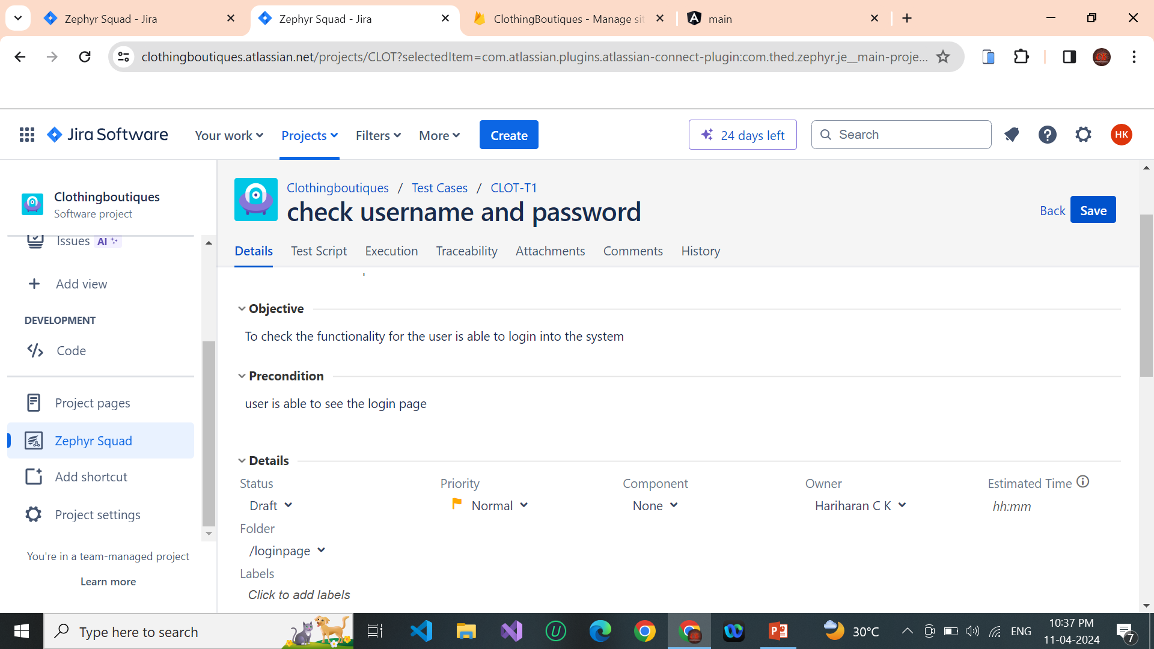
STEP 12 : WE CREATE NEW FOLDER AND CREATE THE NEW TEST CASE TO TYPING THE CASES

Slide 13
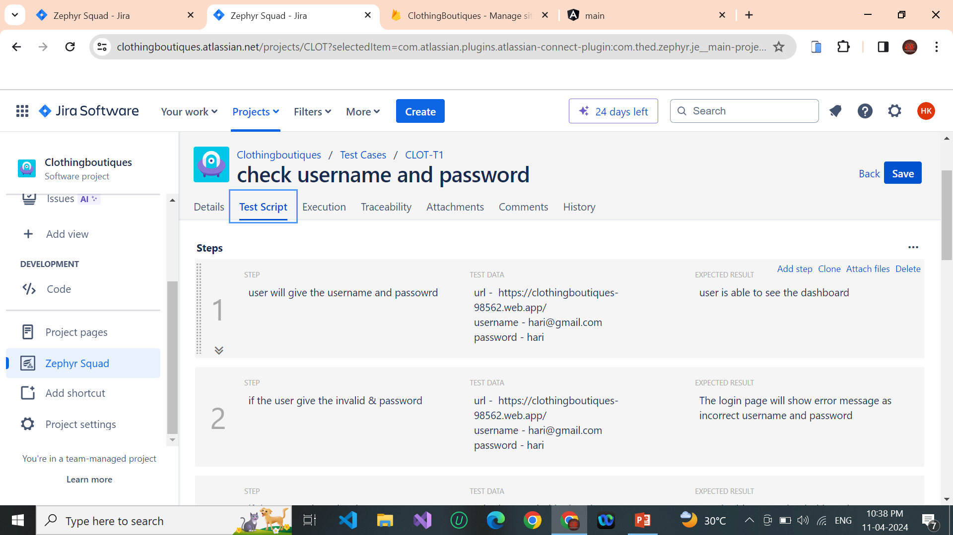
STEP 13 : AFTER WE ENTER DETAILS TO CLICK THE TEST SCRIPT TYPEING THE STEPS, TESTDATA AND EXPECTED RESULTS AND CLICK ON THE SAVE BUTTON

Slide 14
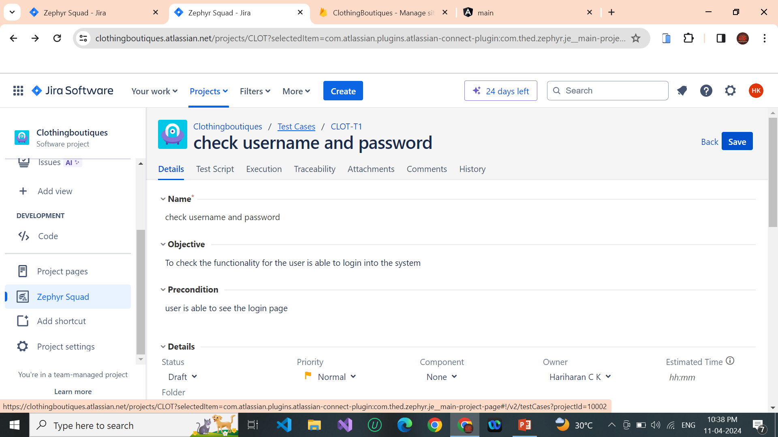
STEP 14 : CLICK THE TOP TEST CASE AND GOBACK THE TESTCASE DASHBOARD

Slide 15
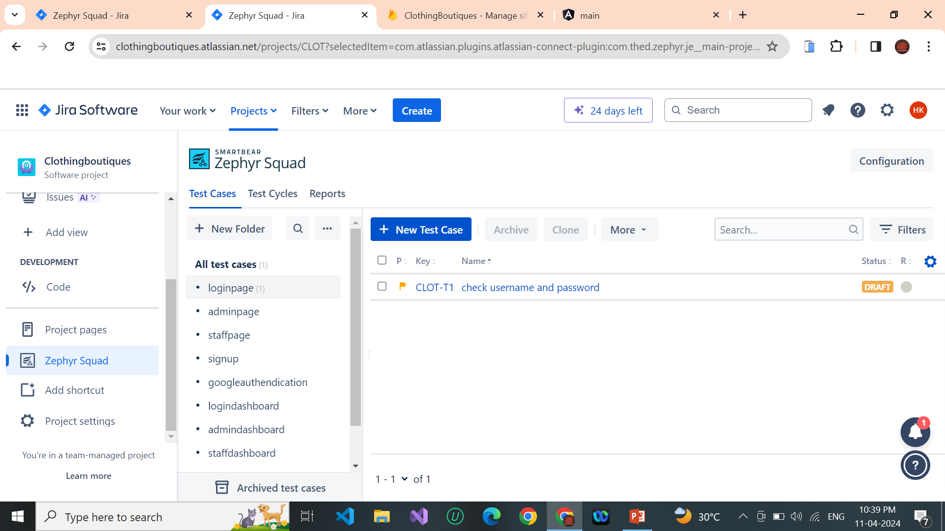
STEP 15 : CHECK THE TEST CASES INSERTED

Slide 16
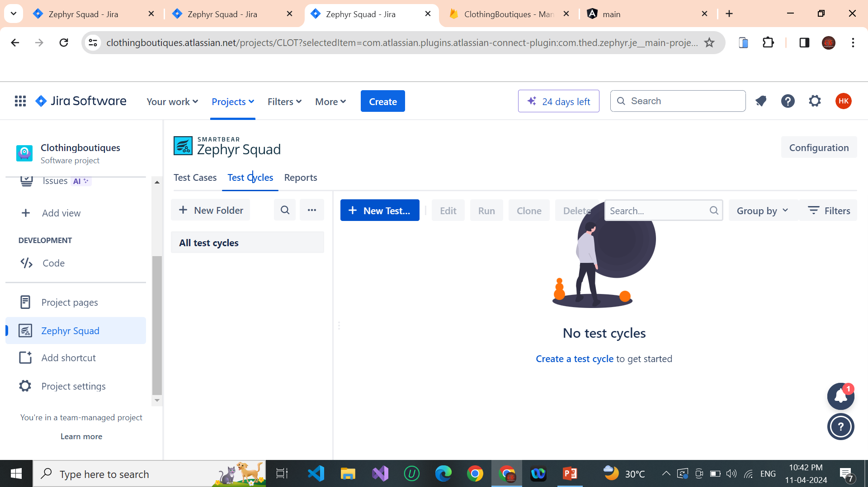
STEP 16 : CLICK THE TEST CYCLES…

Slide 17
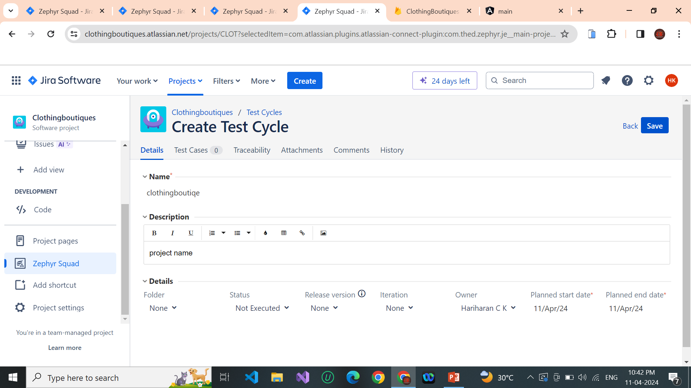
STEP 17 : CREATE THE PROJECT NAME AND DESCRIPTION

Slide 18
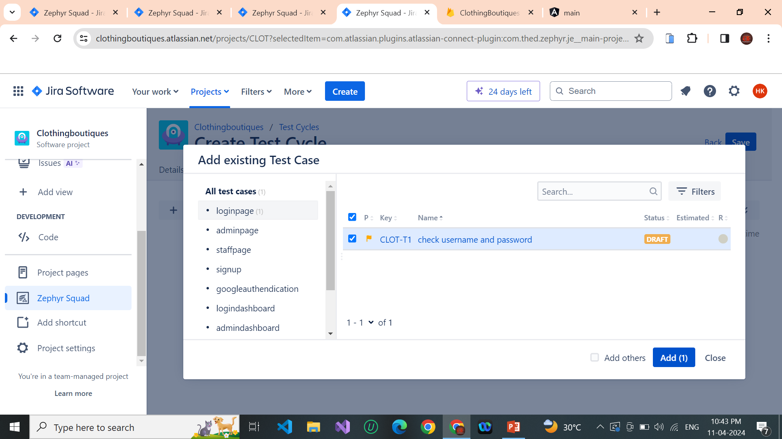
STEP 18 : AFTER TO SELECT THE CASE AND CLICK ADD BUTTON

Slide 19
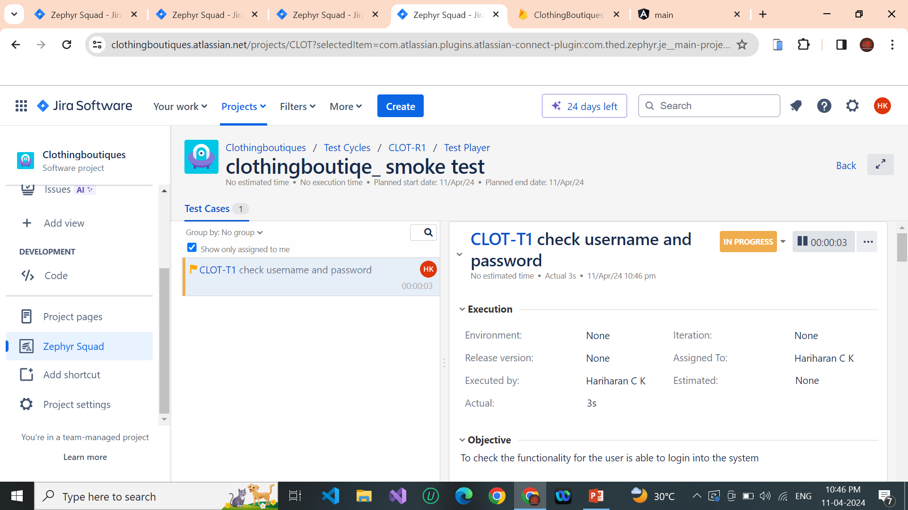
STEP 19 : AFTER WE CHECK THE SMOKE TEST OF TEST PLAYER

Slide 20
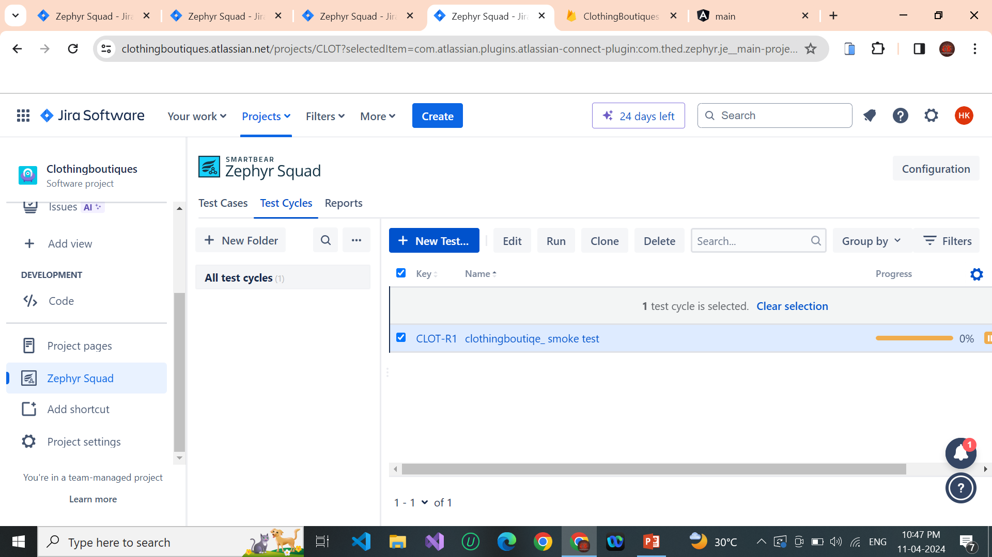
STEP 20 : STOP THE TEST PLAYER AND WE SEE TO CHECK THE HOW IT WILL BE TEST CYCELS RUN

